Slide 1
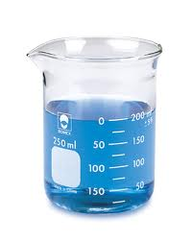
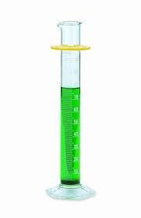
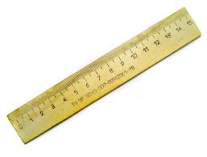
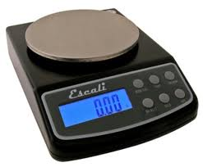
Measuring Matter

Slide 2
Learning Objectives
I can measure length using the metric side of the ruler.
I can find the mass of an object using a balance.
I can know the difference between mass and weight.
I can find the volume of an object by using the water displacement method or length x width x height.
I can calculate density.
I can find relative density by how liquids layer.

Slide 3
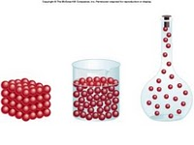
Mass, Volume, & Density

Slide 4
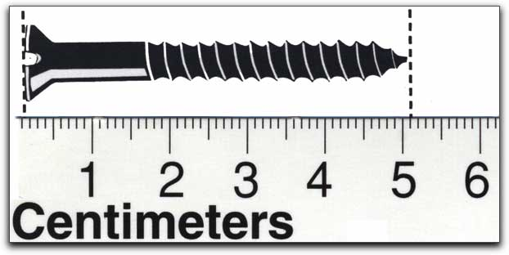
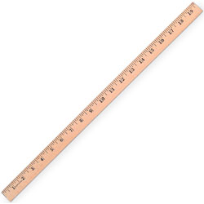
Length
Length - the distance from end to end of an object
Tools: Meter Stick , Metric Ruler
Units: Meter (m), Centimeter (cm)

Slide 5
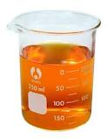
Measuring Mass
A balance is used to measure mass.
The metric system uses grams (g)
If you are measuring a liquid, do not forget to subtract the mass of the container.

Slide 6
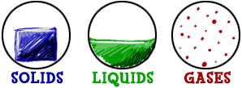
Mass vs. Weight
Mass - the amount of matter in an object
Measured with a balance
Does not change
Units - grams
Weight - a measurement of the gravitational force acting on an object
Measured with a scale
Changes depending on gravity
Units - pounds

Slide 7
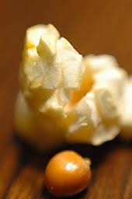
Measuring Volume
Volume is the amount of space that an object takes up.
Which has more volume; a popcorn kernel or a piece of popped corn?

Slide 8
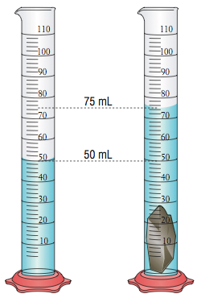
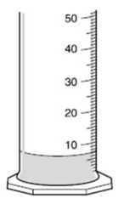
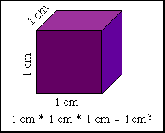
Volume
Volume: is the amount of space that matter takes up
Volume can be in the form of a solid, liquid, or gas.
There are three different types of volume:
1. Liquid Volume
2. Regular Volume
3. Irregular Volume

Slide 9
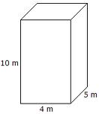
Volume of a Regular Shaped Solid
A regular shaped solid would be one that you could easily measure the length, width, and height using a ruler.
LENGTH X WIDTH X HEIGHT
Measures in cm cubed.

Slide 10
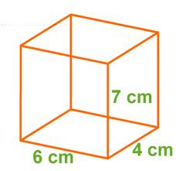
Volume of a Regular Solid Practice Problem
Tools: Ruler or Meter Stick
Units: Centimeters Cubed (cm³)
  1 cm³ = 1 mL
Volume = L x W x H
6 cm x 4 cm x 7 cm = 168 cm³

Slide 11
Volume of an Irregular Shaped Solid
An irregular shaped solid would be a solid object that could not be easily measured by a ruler.
Example: a rock or a cap eraser.
When this is the case, you look at water displacement in a graduated cylinder. This is measured in ml.

Slide 12
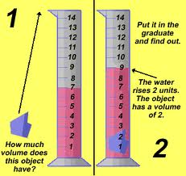
Volume of an Irregularly Shaped Solid
Tool: Graduated Cylinder
Units: (cm³)
Water Displaced Method
Put a set quantity of water into the graduated cylinder and note the starting volume
Place the irregularly shaped object into the graduated cylinder
The water will rise - record the new volume
The difference between the new and starting volumes is the volume of the irregular object

Slide 13
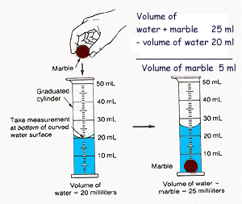

Slide 14
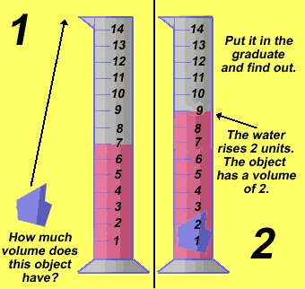

Slide 15
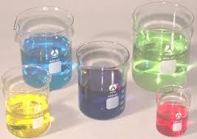
Volume of a liquid
To find the volume of a liquid, you simply pour it into a beaker or a graduated cylinder and read it in ml.

Slide 16
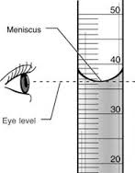
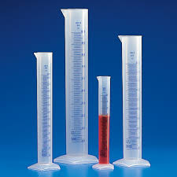
Liquid Volume
Tool: Graduated Cylinder
Units: milliliters (mL)
liters (L)
What is a meniscus?
  A meniscus is the curved surface of a liquid

Slide 17
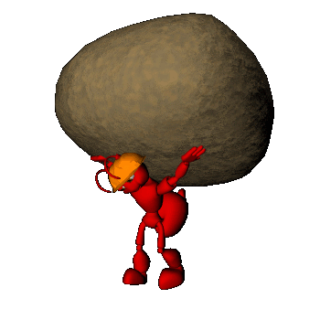
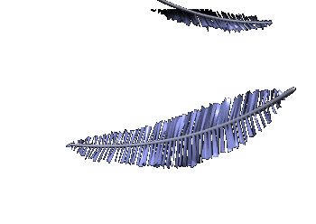
Which do you think would have the greater volume? The greater mass?
Why?
1 kg of rocks
1 kg of feathers

Slide 18
What is Density?
Density is the amount of matter in a given space.
Density is a physical property because it can be observed/measured without changing the object.
Density can be used to identify substances because no two substances have the same density.
Density does not depend on size or shape - the density of a single substance will remain the same no matter the sample’s size or shape.

Slide 19
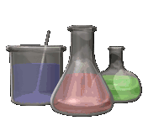

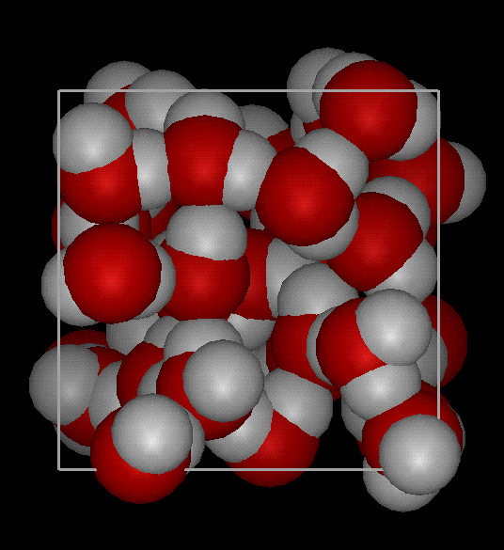
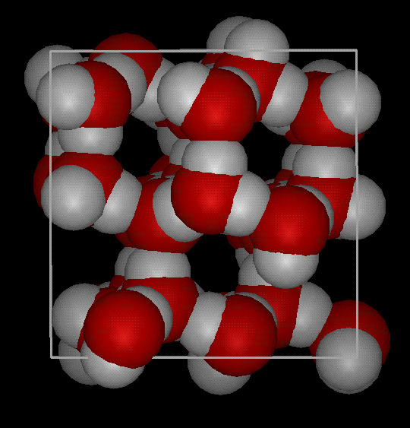
DENSITY
Density is a measure of how tightly packed and how heavy the molecules are in an object. Density is the amount of matter within a certain volume (or space).
Notes:
Density is the amount of matter within a certain volume.

Slide 20
Which one is more dense?
How about this: Which square is more dense?

Slide 21
Which one is more dense?
Now which one is more dense?

Slide 22
To find the density
1- Find the mass of the object – balance.
2- Find the volume of the object – Is it a regular shaped object, an irregular shaped object, or a liquid?
3- Divide
Density = Mass
Volume

Slide 23
Density Formula
Density is the amount of mass in a given space (volume).
The formula for density is...
Mass
Density = ---------------
Volume
Units for density…
  Solid = g/cm³
  Liquid = g/mL

Slide 24
Density T-Triangle
m = mass v = volume D = density
The Density T-Triangle can be used to write 3 different formulas.
Formula for density: D = m/v
Formula for mass: m = D x v
Formula for volume: v = M/D
m
D
v

Slide 25
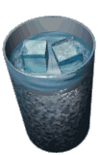
Proof that water and ice have different densities

Slide 26

To find density:
Find the mass of the object
Find the volume of the object
Divide : Density = Mass - Volume
Ex. If the mass of an object is 35 grams and it takes up 7 cm³ of space, calculate the density
Set up your density problems like this:
Given: Mass = 35 grams Unknown: Density (g/cm³ cm³) Volume = 7 cm³
Formula: D = M / V
Solution: D = 35g/7 cm³
D = 5 g/cm³

Slide 27


Let’s try a density problem together
Frank has a paper clip. It has a mass of 9g. Paper clip was lowered into a graduated cylinder holding a volume of water equal to 2.0 mL.The height of the water rose to 5mL. What is its density?
Given/Unknown | Work
D = m = v =
?
5 – 2 = 3ml = 3cm³
9g
3cm³
$$D= \frac{9g}{3cm3}$$
$$D=\frac{m}{v}$$
= 3g/cm³

Slide 28

Let’s try a density problem together
Frank also has an book. It has a mass of 12g. The book has a length of 3cm, and width of 2cm, and a height of 2cm. What is its density?
Given/Unknown | Work
D = m = v =
?
3cm(2cm)(2cm)= 12cm³
12g
12cm³
$$D= \frac{12g}{12cm3}$$
$$D=\frac{m}{v}$$
= 1g/cm³

Slide 29

Let’s try a density problem together
A book has a density of 10 g/cm³. What would be the mass of the book if the volume is 5cm³.
Given/Unknown | Work
D = m = v =
10g/cm³
?
5cm³
= 50g
$$D=\frac{m}{v}$$
M =d(v)
$m=10g/cm3$(5cm³⁾

Slide 30

Change Mass AND Keep Volume Same
Ways to Affect Density
Increase the mass → increase density
Decrease the mass → decrease in density
Which container has more density?
A B

Slide 31
Change Volume AND Keep Mass Same
Ways to Affect Density
Increase the volume → decrease density
Decrease the volume → increase density
Which container has more density?
A B

Slide 32
In your notebook illustrate the answer to the following question:
What 2 ways will INCREASE density?

Slide 33
What 2 ways will INCREASE density?
Keep the same mass AND decrease the volume
Keep the same volume AND increase the mass

Slide 34
Liquid Layers
If you pour together liquids that don’t mix and have different densities, they will form liquid layers.
The liquid with the highest density will be on the bottom.
The liquid with the lowest density will be on the top.
Objects or substances with MORE density will sink below objects or substances with LESS density
  Which do you think is MORE dense,
  Water or Oil???

Slide 35
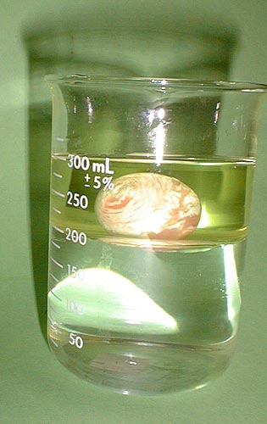
Water, Oil…and a Superball
The oil is less dense than the water, so it’s on top. The superball is less dense than water, but more dense than oil, so it sinks to the bottom of the oil layer, yet floats on the top of the water layer.

Slide 36
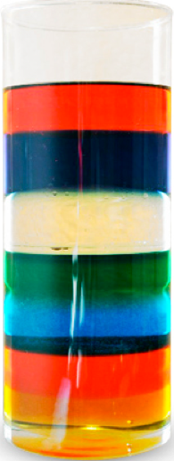
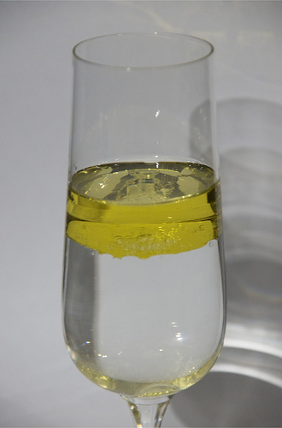
If you have 2 or more substances,
  the MORE dense substance will be on bottom
  The LESS dense substance will be on top

Slide 37
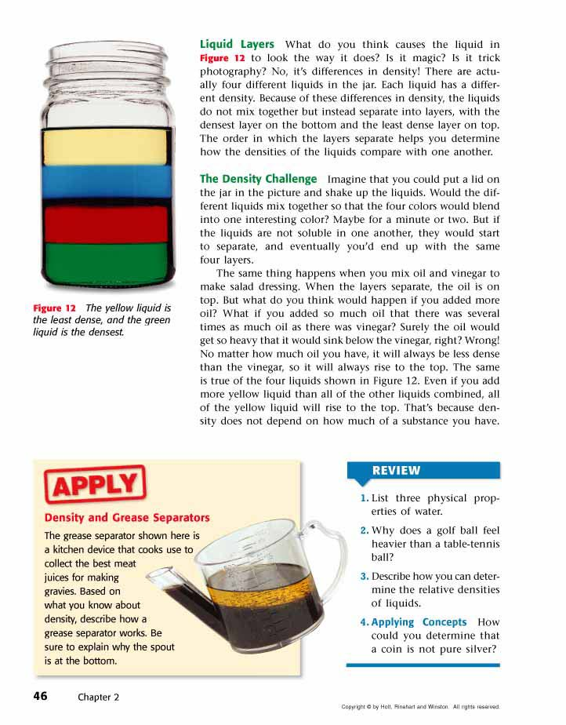
Liquid Layers
Check out this picture. Which layer has the highest density?
Which layer has the lowest density?
Imagine that the liquids have the following densities:
  10g/cm³. 3g/cm³.
  6g/cm³. 5g/cm³.
Which number would go with which layer?
3 g/cm³
5 g/cm³
6 g/cm³
10 g/cm³

Slide 38
Sink or Float
The Density of Water is 1 g/mL
An object/material will sink in water if it has a density greater than 1 g/mL.
An object/material will float on water if has a density less than 1 g/mL.
Practice Problem:
Will a material with a mass of 110 g and a volume of 312 cm^3 float on or sink in water?
Claim:
Evidence:
Reasoning:

Slide 39
Review
What is the formula for density?
What happens if you pour together liquids that have different densities?
Will the liquid on the top have the highest or lowest density?
Will the liquid on the bottom have the highest or lowest density?

Slide 40
Super Scientist Question of the Day
Jake has a book, a ruler, and a balance.
How can Jake find the density of the book with the tools he has?

